Slide 1
Introduction to Project Management
Software Project Management
Notes:
Opening Slide

Slide 2
Introduction to Project Management
Software Project Management
Roadmap
Interest in project management
Track record of IT projects
Advantages of project management
Project
Project constraints
Project management
Project management framework
Improving the track record of IT projects
Project success criteria
Programs
Project management software
Notes:
Opening Slide

Slide 3
SPM
Introduction to Project Management
Interest in project management
There seems to be new or renewed interest in project management. We need to determine the forces behind the new or renewed interest.
Project management has emerged and expanded because the characteristics of our turn-of-the-century society demands the development of new methods of management. Many forces have fostered the emergence and expansion of project management, including the following major ones:
  Exponential expansion of human knowledge e.g. more than 16 million people regard project management as their profession; the number of people earning their Project Management Professional (PMP) certification continues to increase.
  Growing demand for a broad range of complex, sophisticated, customized goods and services e.g. total global spending on technology goods, services, and staff was projected to reach $2.4 trillion in 2008, an 8% increase from 2007; narrow product launch windows.
  Evolution of global competitive markets for the production and consumption of goods and services. ICT infrastructure, S/W, and the use of interdisciplinary and global work teams have radically changed the work environment.
Notes:
Introduction

Slide 4
SPM
Introduction to Project Management
Track record of IT projects
In 1995, the Standish Group published a study entitled “CHAOS”. The study found that:
Only 16.2% of IT projects in US were successful in meeting project goals on time and on budget.
Over 31% of IT projects in US were canceled before completion (costing companies and government agencies over US$ 81 billion).
In 2004, PricewaterhouseCoopers did a study of 200 companies from 30 different countries about their project management maturity. The study found that:
Over 50% of all projects fail.
Only 2.5% of corporations consistently meet their targets for scope, time, and cost goals for all types of project.
The above findings do emphasize the need to incorporate formal project management especially in the IT industry.
Notes:
Introduction

Slide 5
SPM
Introduction to Project Management
Advantages of project management
Better control of financial, physical, and human resources
Improved customer relationships
Shorter development time
Lower costs
Higher quality and increased reliability
Higher profit margins
Improved productivity
Better internal coordination
Higher worker morale (confidence, cheerfulness, emotion, willing to succeed)
Notes:
Introduction

Slide 6
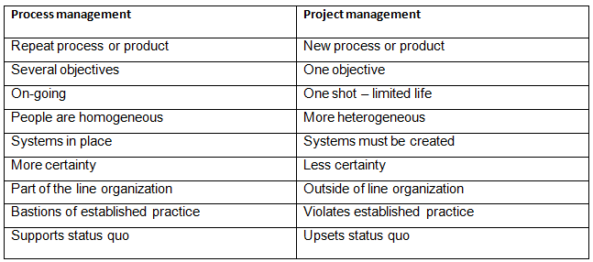
SPM
Introduction to Project Management
Project
What is a project?
A temporary endeavor(i.e., effort) undertaken to create a unique product, service, or result (PMBOK Guide).
A unique venture with a beginning and an end, conducted by people to meet established goals within parameters of cost, schedule and quality.
Projects end when their objectives have been reached or the project has been terminated.
Projects can be large or small, and can take a short or long time to complete.
Notes:
Introduction

Slide 7
SPM
Introduction to Project Management
Attributes of a project
There are several attributes that are unique about a project, including:
Unique purpose
Temporary (definite start and end dates; one-time ‘process’)
Developed using progressive elaboration
Requires resources, often from various areas (and is limited by cost, schedule, and resources)
Should have a primary customer or sponsor: project sponsor usually provides the direction and funding for the project; customer-focused
Involves uncertainty
Question: What is an IT project, and how is it different from traditional projects?
Examples of IT projects:
A small software development team adds a new feature to an internal software application for the finance department.
A college campus upgrades its infrastructure to provide campus-wide wireless Internet access.
A company decides what VoIP system to purchase and how it will be implemented.
Notes:
Introduction

Slide 8
SPM
Introduction to Project Management
Project constraints
Projects are constrained by scope, time, and cost.
These limitations are sometimes referred to in PM as the triple constraint.
Scope: What work will be done as part of the project? What unique product, service, or result does the customer or sponsor expect from the project?
Time: How long should it take to complete the project? What is the project’s schedule?
Cost: What should it cost to complete the project? What is the project’s budget? What resources are needed?
The project manager must consider scope, time, and cost and balance these three often-competing constraints.
Notes:
Introduction

Slide 9
SPM
Introduction to Project Management
Project constraints (contd.)
Other people focus on the quaduple constraint, which includes quality.
Quality: How good does the quality of the products or services need to be? What do we need to do to satisfy the customer?
Some people suggest the four constraints plus risk.
Risk: How much uncertainty are we willing to accept on the project?
Note: Project managers must not only strive to meet specific scope, time, cost, risk, and quality requirements of projects, they must also facilitate the entire process to meet the needs and expectations of the people involved in or affected by project activities.
Notes:
Introduction

Slide 10
SPM
Introduction to Project Management
Project management
Project management is the application of knowledge, skills, tools and techniques to project activities to meet project requirements.
Recall that project managers must not only strive to meet specific scope, time, cost, risk, and quality requirements of projects, they must also facilitate the entire process to meet the needs and expectations of the people involved in or affected by project activities.
Notes:
Introduction

Slide 11
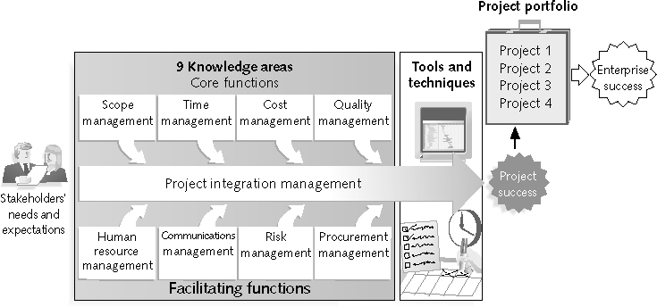
SPM
Introduction to Project Management
Project management framework
Notes:
Introduction

Slide 12
SPM
Introduction to Project Management
Project management framework (contd.)
Stakeholders
These are the people involved in or affected by project activities. They include :
Project sponsor
Project manager
Project team
Support staff
Customers
Users
Suppliers
Opponents to the project
Question: Who are customers and users?
Stakeholders’ needs and expectations are important in the beginning and throughout the life of a project. Successful project managers develop good relationships with project stakeholders to understand and meet their needs and expectations.
Notes:
Introduction

Slide 13
SPM
Introduction to Project Management
Project management framework (contd.)
9 Project Management Knowledge Areas
The knowledge areas describe the key competencies that project managers must develop. They are defined below:
Project scope management involves working with all appropriate stakeholders to define, gain written agreement for, and manage all the work required to complete the project successfully.
Project time management includes estimating how long it will take to complete the work, developing an acceptable project schedule given cost effective use of available resources and ensuring timely completion of the project.
Project cost management consists of preparing and managing the budget for the project.
Project quality management ensures that the project will satisfy the stated or implied needs for which it was undertaken.
Project human resource management is concerned with making effective use of the people involved with the project.
Project communications management involves generating, collecting, disseminating, and storing project information.
Notes:
Introduction

Slide 14
SPM
Introduction to Project Management
Project management framework (contd.)
9 Project Management Knowledge Areas (contd.)
Project risk management includes identifying, analyzing, and responding to risks related to the project.
Project procurement management involves acquiring or procuring goods and services for a project from outside the performing organization.
Project integration management is an overarching function that coordinates the work of all other knowledge areas. It affects and is affected by all of the other knowledge areas.
Notes:
Introduction

Slide 15
SPM
Introduction to Project Management
Project management framework (contd.)
Project Management Tools and Techniques
They assist project managers and their teams in various aspects of project management. Some specific ones include:
Scope statement, WBS, etc (scope)
Gantt charts, network diagrams, critical path analysis, etc (time)
Cost estimates, earned value, etc (cost)
Etc
Notes:
Introduction

Slide 16
SPM
Introduction to Project Management
Improving the track record of IT projects
A follow-up study by the Standish Group regarding the “CHAOS” study showed some improvements in IT projects in the US:
The number of successful projects has doubled, from 16% in 1994 to 32% in 2008.
The number of failed projects decreased from 31% in 1994 to 24% in 2008.
The study describes what factors contribute most to the success of IT projects
Executive support
User involvement
Experienced project manager
Clear business objectives
Minimized scope
Standard software infrastructure
Firm basic requirements
Formal methodology
Reliable estimates
Notes:
Introduction

Slide 17
SPM
Introduction to Project Management
Project success criteria
There are several ways to define project success:
The project met scope, time, and cost goals.
The project satisfied the customer or sponsor.
The results of the project met its main objectives, such as making or saving a certain amount of money, providing a good return on investment.
Notes:
Introduction

Slide 18
SPM
Introduction to Project Management
Programs
In the context of project management, a program is a group of related projects managed in a coordinated way to obtain benefits and control not available from managing them individually.
Examples of programs:
An IT company may have three programs such as system development, ICT infrastructure, and ICT research, such that the programs handle system development projects, ICT infrastructure projects, and ICT research projects respectively.
A clothing firm may have a program to analyze customer-buying patterns. Projects under this program might include one to send out and analyze electronic surveys, one to conduct several focus groups in different geographic locations with different types of buyers, and a project to develop an information system to help collect and analyze current customers’ buying patterns.
A construction firm may have programs for building single-family homes, apartment buildings, and office buildings.
Notes:
Introduction

Slide 19
SPM
Introduction to Project Management
Project management software
There are hundreds of different software products for supporting project management.
The choice could depend on factors such as: the size of the project, number of projects to be supported by the product, number of project team members who will need to use the product, whether the project team members and are dispersed and will require collaboration, enterprise requirements (e.g. integration with other parts of the enterprise), etc.
Examples: Microsoft Project, Microsoft Enterprise Project Management, ApolloHQ, etc.
Free and open-source project management tools include:
OpenProj (www.openproj.org)
Zoho Project (www.projects.zoho.com)
Open Workbench (www.openworkbench.org)
Freedcamp (freedcamp.com)
dotProject (www.dotproject.net)
TaskJuggler (www.taskjuggler.org)
etc
Notes:
Introduction

Slide 20
SPM
Introduction to Project Management
AOB
Any Questions?
Notes:
Introduction

